Slide 1

Team Contributions
Content was divided among all three team members for faster project completion. Equal efforts and equal contributions were provided by all team members for completing the project and deliverables were provided timely.
Durga Srikari Maguluri
Project Workflow
Data Collection and data retrieval with the help of web scrapping and MS Excel.
Project Presentation
Naveen Putta
Data Analysis
Utilized Big Query to conduct in-depth data analysis.
Data Preprocessing
Employed Open Refine to clean and prepare the data for analysis
Jayadeep Bisati
Data Visualization
Created insightful visual representations of data using Looker Studio.
ADTA 5240 - Group 11 Project
World countries by population
Team: Durga Srikari Maguluri, Naveen Putta, Jayadeep Bisati

Slide 2

Objectives
Generation/Collection of Data using Web Scrapping
Data Preprocessing using Open Refine and M S Excel
Storage of the Data using Big Query
Data Analysis using Big Query
Data Visualization using Looker Studio
Interpretation of Data
Conclusion
World countries by population

Slide 3








World countries by population
For this project, we aim to collect data from Wikipedia about world countries and their populations as per the United Nations. We will preprocess the data using Open Refine, and M S Excel, store it in Big Query to perform analysis with the help of SQL, and finally visualize the data using Google Looker Studio.
Data Collection
from Wikipedia using web scraping
Data
Pre-processing
using Open Refine and MS Excel
Data
Storage
using Big Query in GCP
Data
Analysis
using Big Query in GCP
Data
Visualization
using Google Looker Studio in GCP
World countries by population

Slide 4

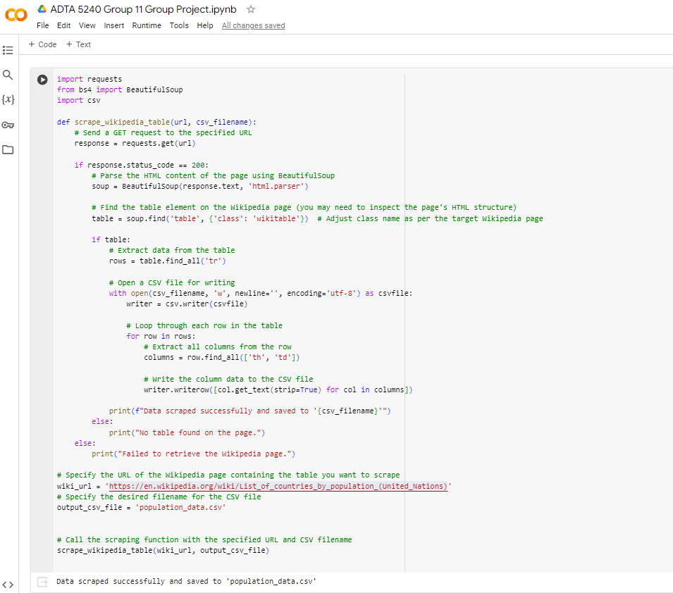
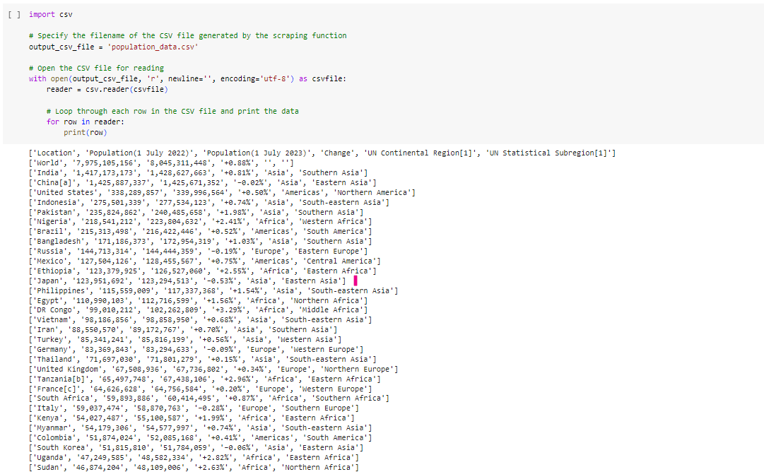
Data Collection (Web Scrapping)
Platform: Python code and google Colab were used web scrape the Wikipedia to retrieve the information about world countries and their populations as per the United Nations
URL used for web scrapping: https://en.wikipedia.org/wiki/List_of_countries_by_population_(United_Nations)
Data Collection Code: Screen shots and Attached File →
Figure 1: Web scrapping and saving data to csv file
Figure 2: Displaying the world population data
World countries by population

Slide 5
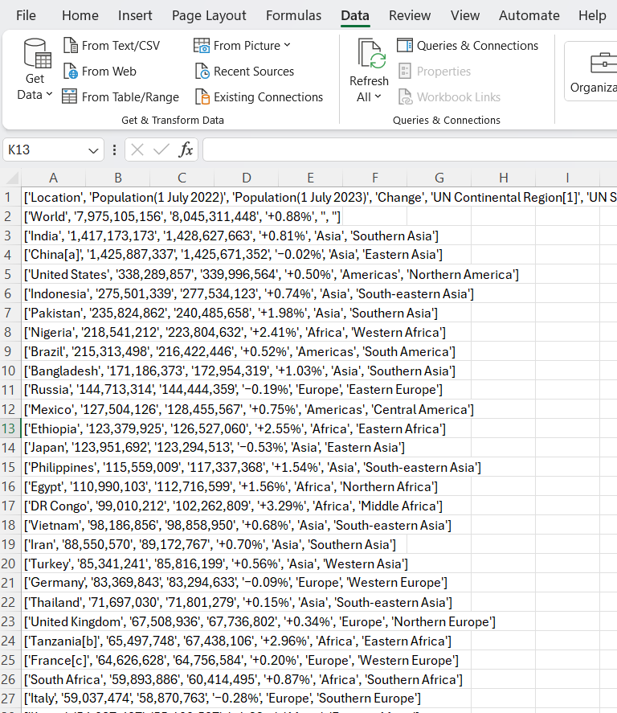
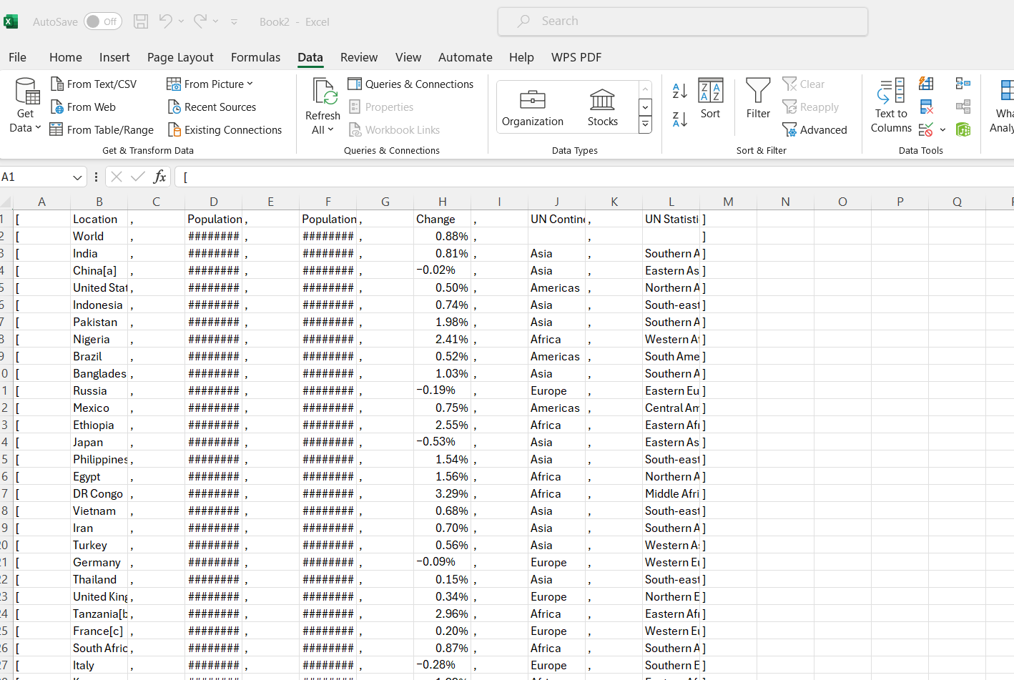
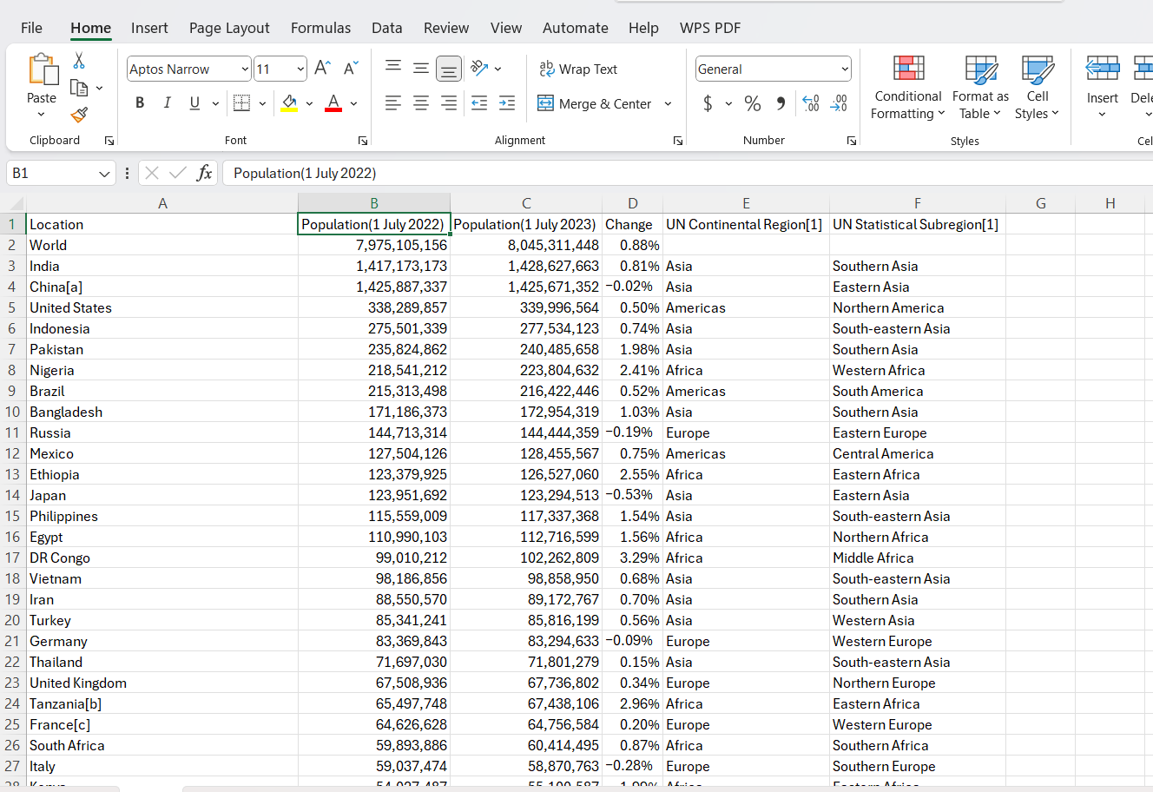
Data Collection (Web Scrapping)
As Google Colab generally is connected to a Google Drive, it does not allow direct download of the data as csv file. Hence, I generated the data in Google Colab and used a feature (text to column) available in MS Excel to retrieve the data of interest for this project. The below figures provide more details.
Figure 3: Raw data from the web scrapping
Figure 4: After using text to column feature
Figure 5: Result data that is input for preprocessing
World countries by population

Slide 6

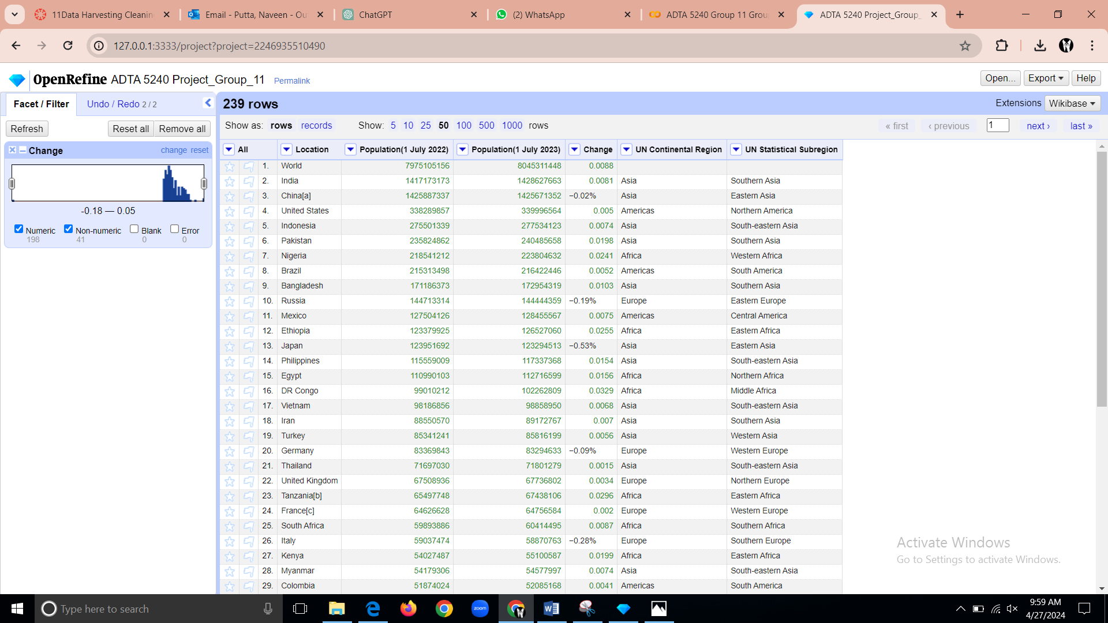
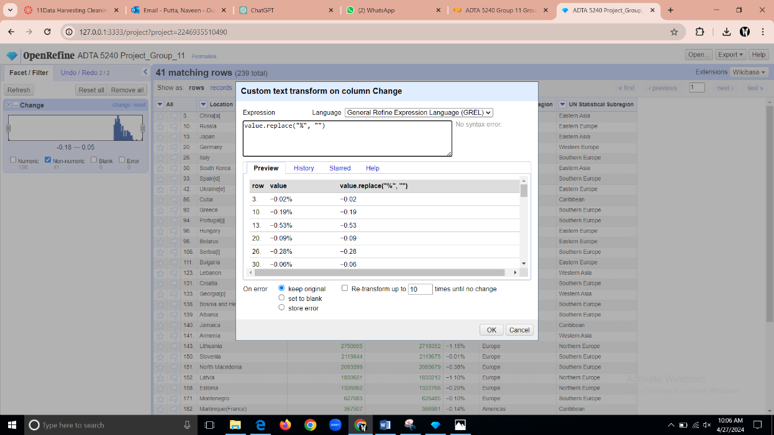
Data Pre-Processing
Here we have used Open Refine for preprocessing techniques below Figure 6 shows that there are 239 rows in total and in the change column there are 198 numeric values(aligned to the right) and 41 non-numeric values(aligned to the left) using open Refine we converted all the non-numeric values to the numeric. First by removing the “%” symbol using the GREL code shown in Figure 7
Figure 6: Total rows, Numeric and Non-Numeric Values
Figure 7: GREL CODE
World countries by population

Slide 7
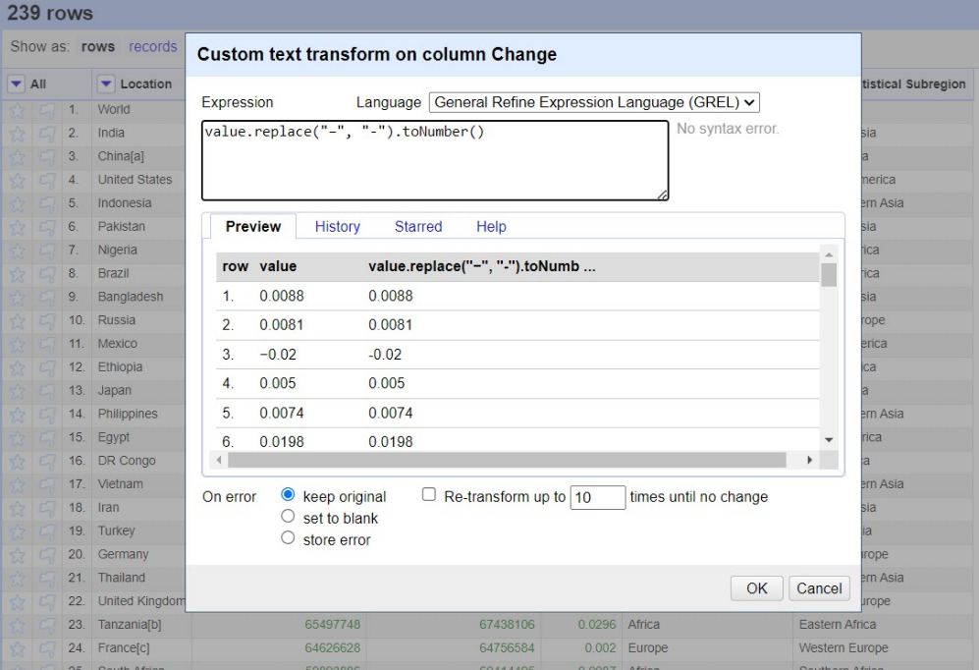
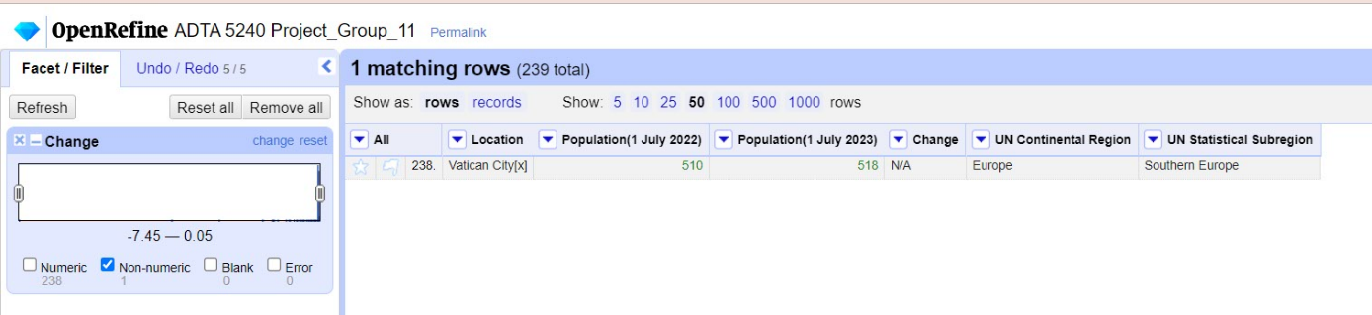
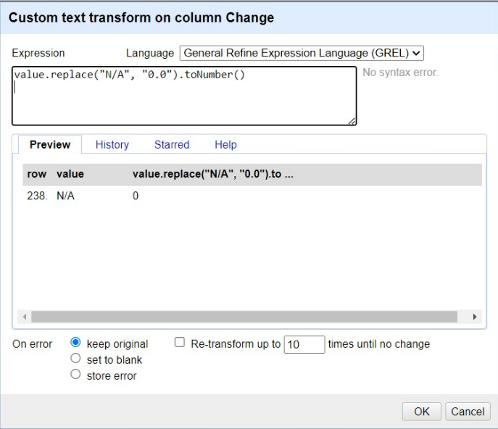
Data Pre-Processing
As in Figure 8 using the GREL code we replaced the “—” with “-” and converted it to the Number(Numeric). After conversion in Figure 9 still that there is 1 Non-numeric value present in the change column i.e., “N/A”(string) using the GREL code(Figure 10) we replaced “N/A” (string) with the “0.0”(string), and then converted to numeric using toNumber() function. Here the value is changed to only zero because in open Refine decimal values cannot be in numeric.
Figure 8: GREL Code to replace the minus sign and convert it
Figure 9: Non-numeric value is present
Figure 10: GREL Code to replace and change to numeric value
World countries by population

Slide 8
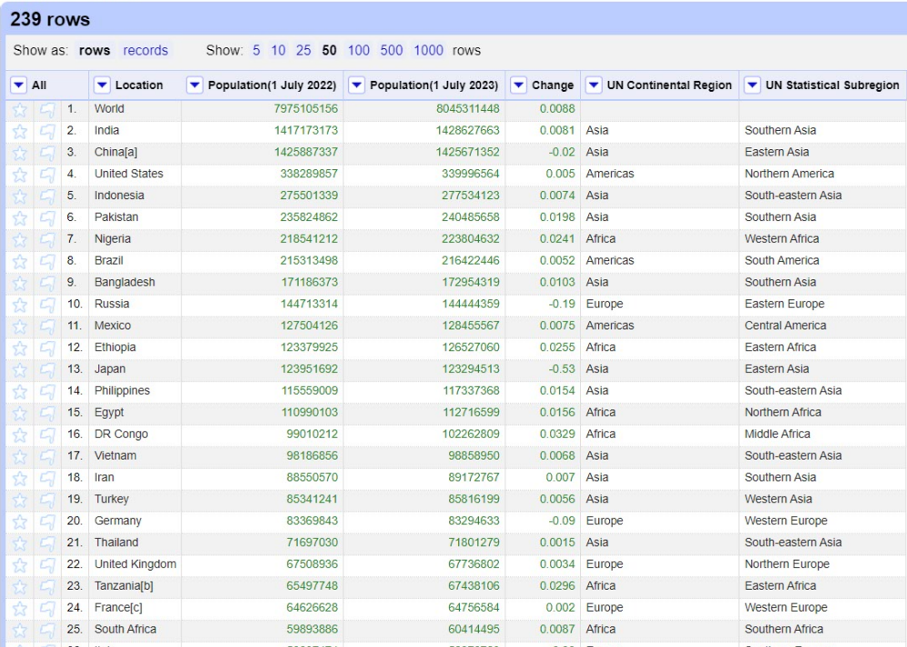
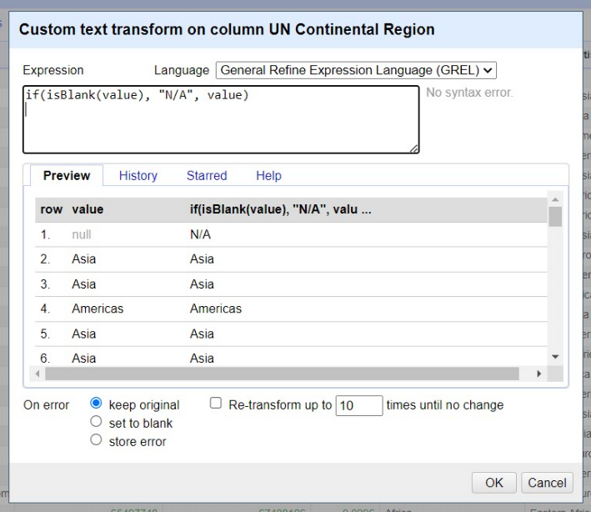
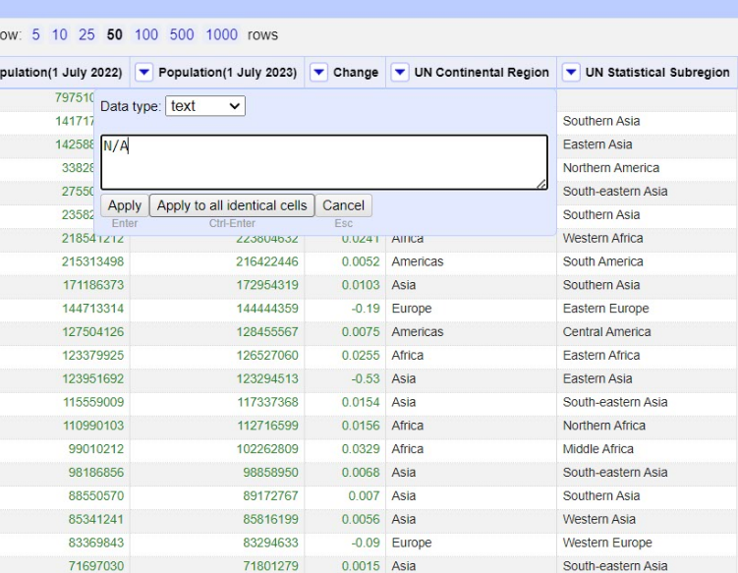
Data Pre-Processing
In Figure 11 the change column values are aligned to the left that represents all the values in the column are changed to numeric values and we can note that the UN Continental Region and UN Statistical Region are empty in the 1st row (world). So, we have replaced the empty row of UN Continental Region with “N/A” using the GREL code shown in Figure 12. Here we have used other technique as there is only one column blank in the UN Statistical Region, we manually edited by clicking on the column and entered “N/A” and then applied(shown in Figure 13).
Figure 11: Change Column Values are preprocessed
Figure 12: Entering the string using GREL code in the UN Continental Region
Figure 13: Entering the string manually in UN Statistical Region
World countries by population

Slide 9
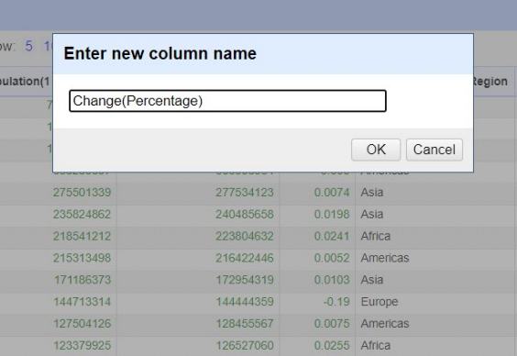
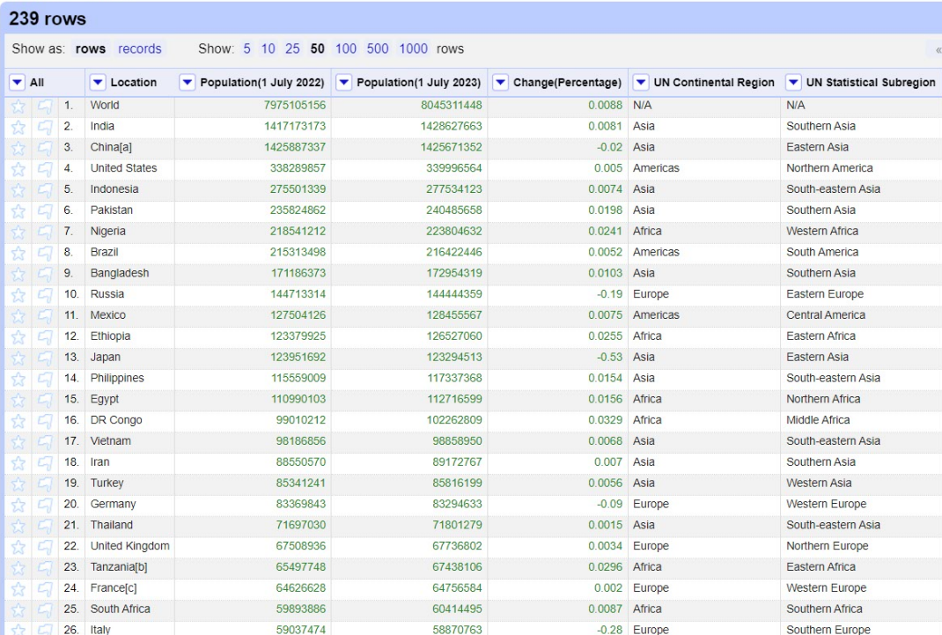
Data Pre-Processing
We strategically choose to change the “change” column in our dataset to “change(percentage)” in the most recent iteration of our data refining process. The reason for this alteration is that each entry in this column indicates a percentage value(shown in Figure 14). Finally, we leveraged Open Refine, a powerful tool for working with messy data. With Open Refine, we executed a series of structured preprocessing techniques to ensure the quality and integrity of our dataset(shown in Figure15)
Figure 14: Changing the column name to change(Percentage)
Figure 15: “Post-Preprocessing Data Overview”
World countries by population

Slide 10

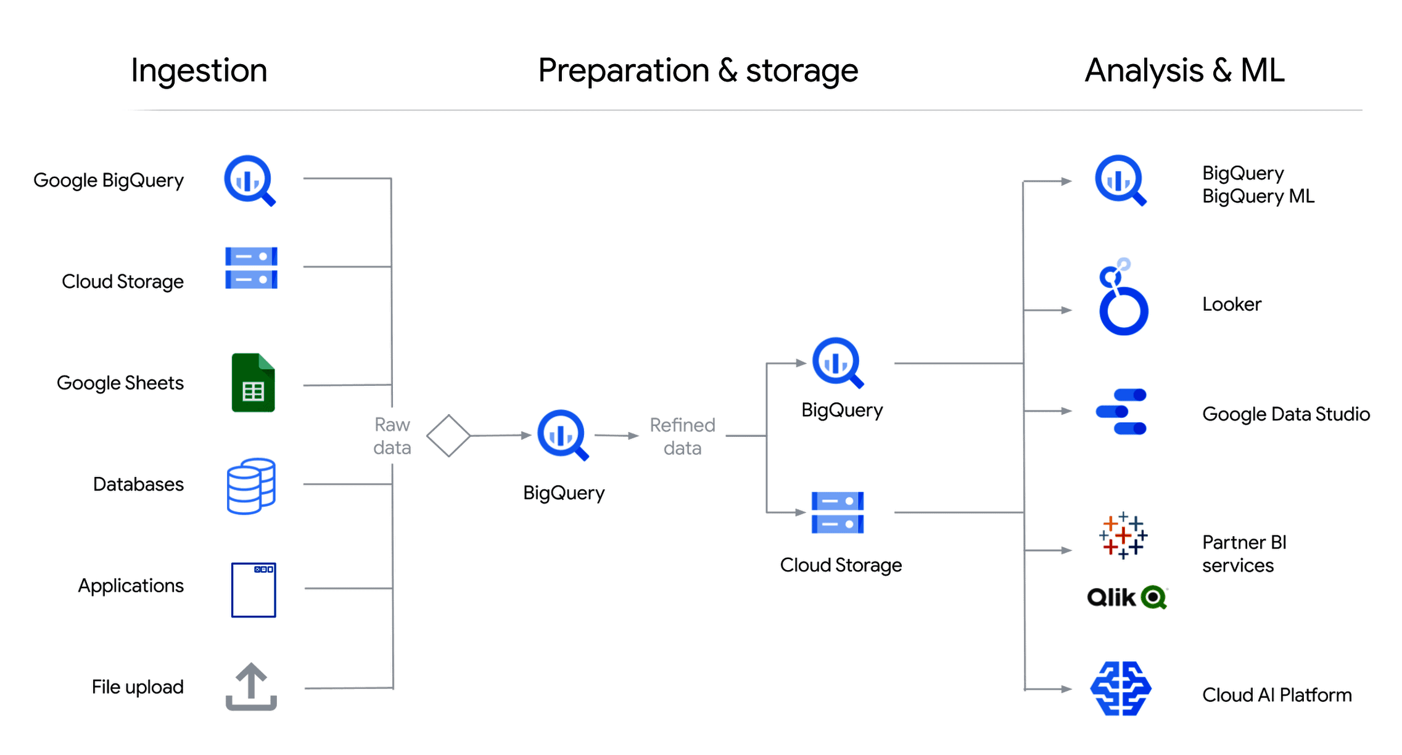
Data Storage (Big Query in GCP)
We have chosen Big Query for our project because of its strong benefits for data analytics and to stay in line with the project requirements. Big Query excels in handling complex datasets, providing robust performance.
The choice of Big Query was keeping in mind its speed and efficiency in processing complex datasets
We will ingest the data as a csv file using the file upload feature
We will use the Big Query to prepare, store, refine, and query the data
We will use Looker Studio for Data Visualization and interpretation
Figure 16: GCP Big Query
World countries by population

Slide 11

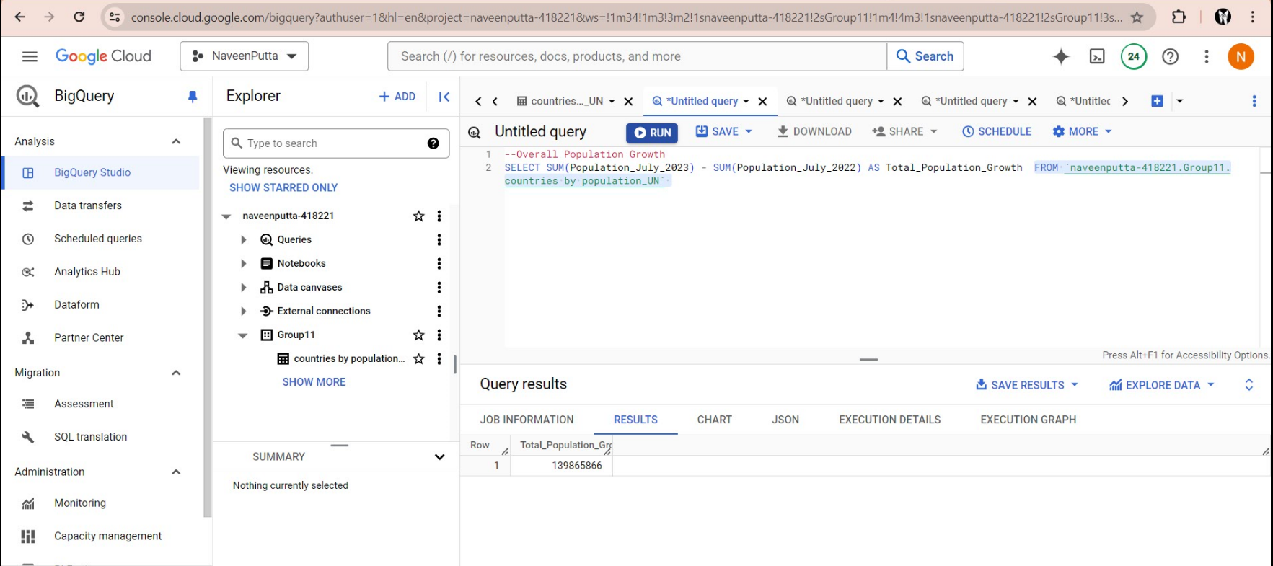
Data Analysis
After preprocessing our dataset with OpenRefine, we uploaded it to Google BigQuery, specifically into a new dataset titled 'Group11' within our project 'naveenputta-418221’.
In this environment, we created a table named 'countries_by_population_UN' to facilitate our analysis. Utilizing Big Query's robust capabilities, we executed five targeted SQL queries to derive meaningful business intelligence of world countries by population. Below are the screenshots of the executed SQL queries alongside their respective results.
These visuals serve to demonstrate the analytical processes applied to our dataset within Google BigQuery and to substantiate the insights derived from our data analysis.
Overall Population Growth: This Query calculates the total population growth from July 2022 to July 2023.
Figure 17: Overall Population Query
World countries by population

Slide 12
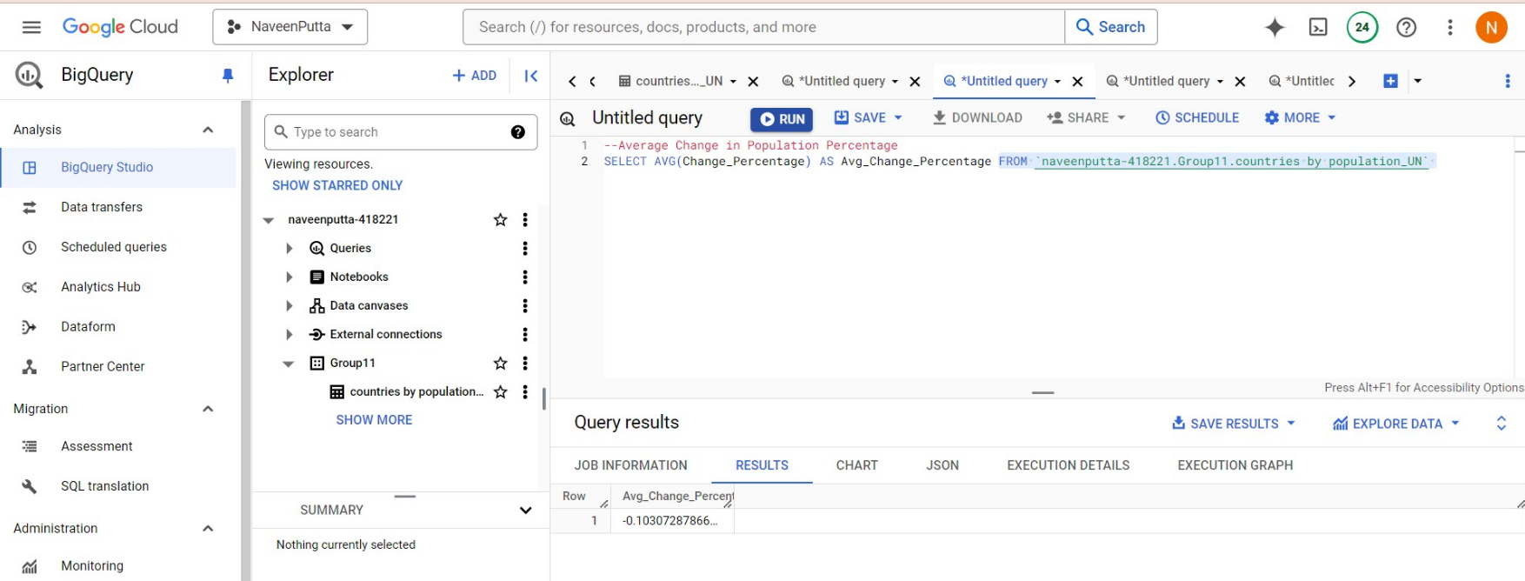
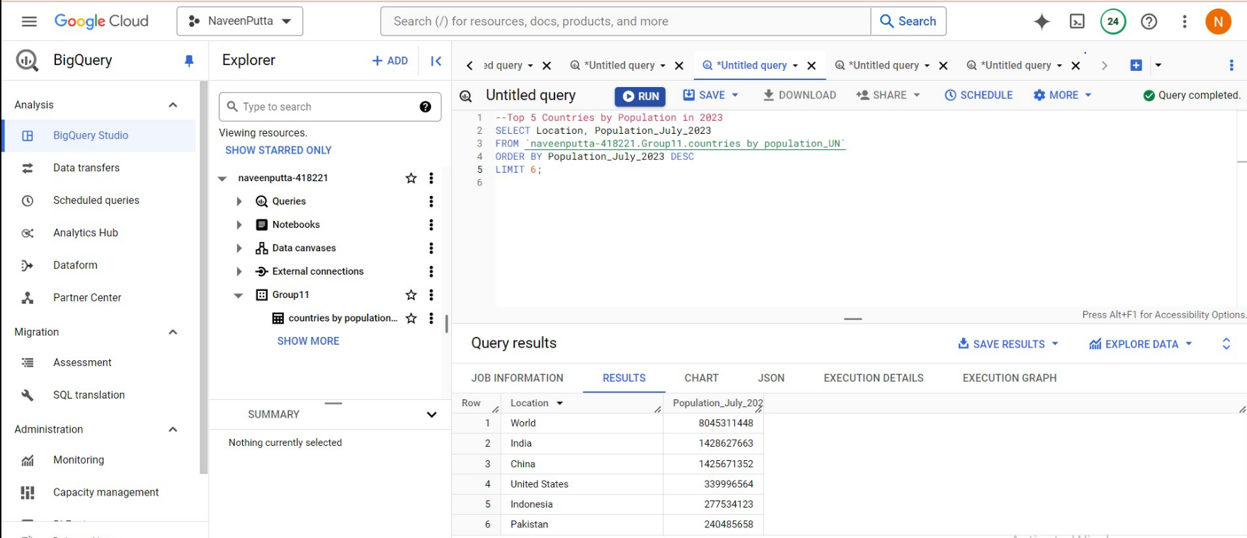
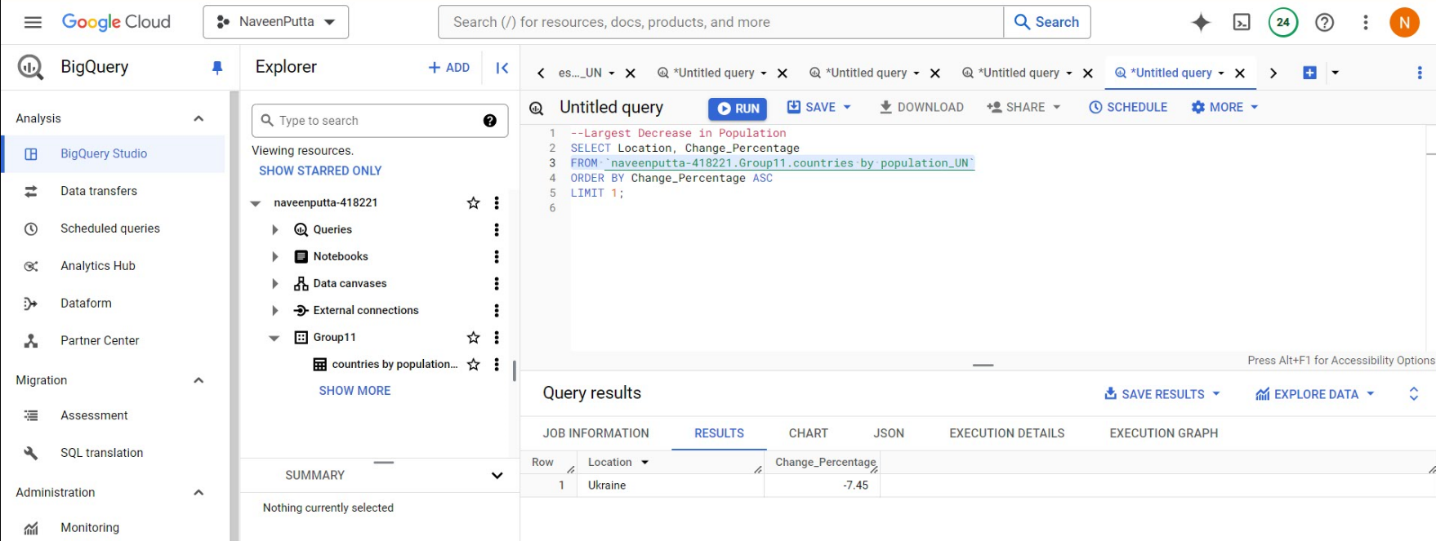
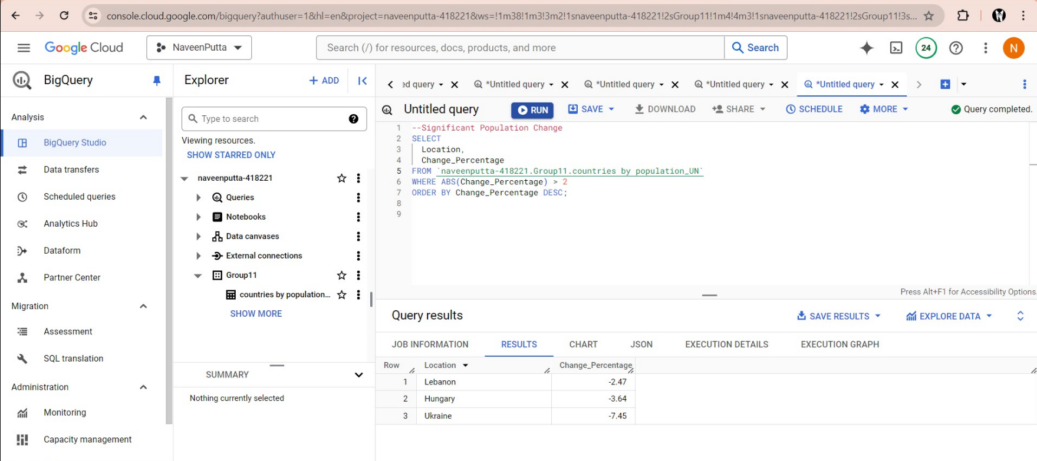
Data Analysis
Figure 18: This query identifies the average population change across all countries
Figure19 : This query lists the top 5 countries by population for the year 2023
Figure 20: This query identifies with largest decrease in the population
Figure 21: This query retrieves countries with significant population change, (>2%)
World countries by population

Slide 13

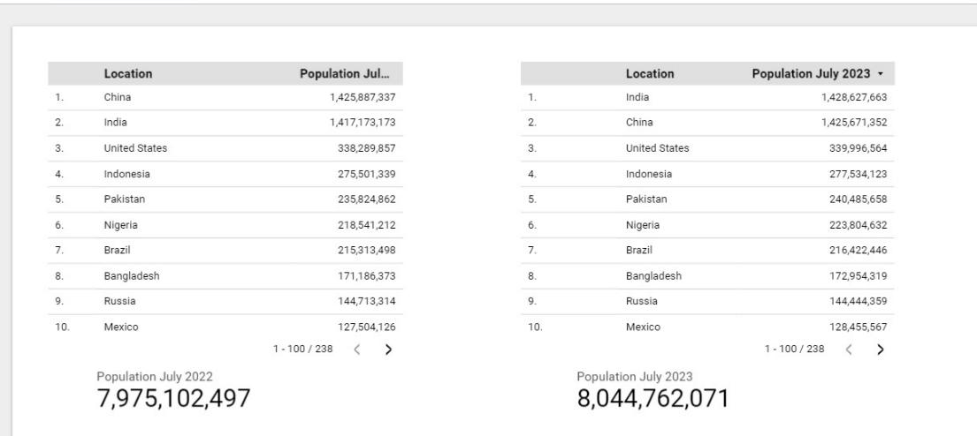
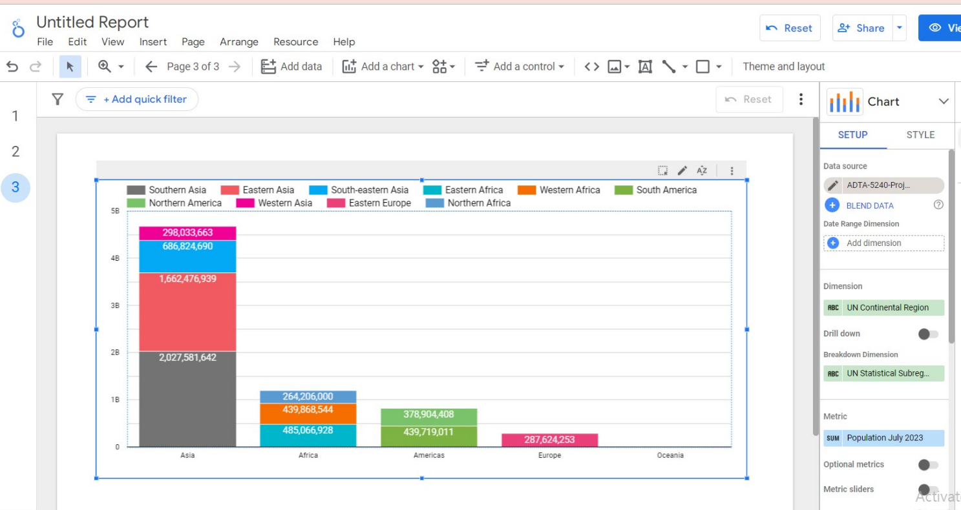
Data Visualization and Interpretation
Following the data analysis conducted in Big Query, we leveraged Looker Studio to create insightful visualizations. This allowed us to transform the complex query results into clear and engaging graphical representations, facilitating easier interpretation and communication of the findings. Each visualization was meticulously designed to highlight key trends and patterns, effectively showcasing the analytical insights derived from our dataset.
Figure 22: The visualization shows the top 10 countries by population for July 2022 and July 2023 where it also shows the total population in the year 2022 and 2023
Figure 23: The above bar chart shows the population distribution across different global regions. Each color-coded segment of the bars represents a sub-region illustrating their population sizes in the year 2023
World countries by population

Slide 14
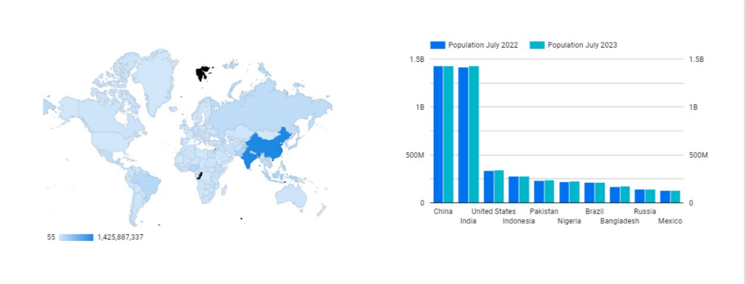
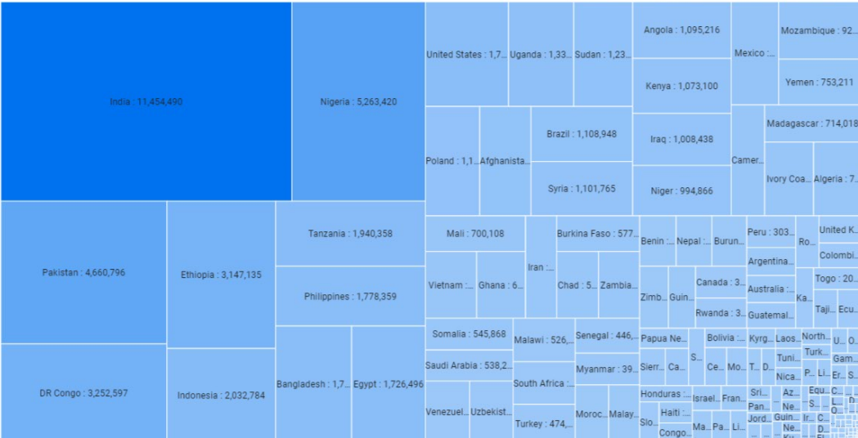
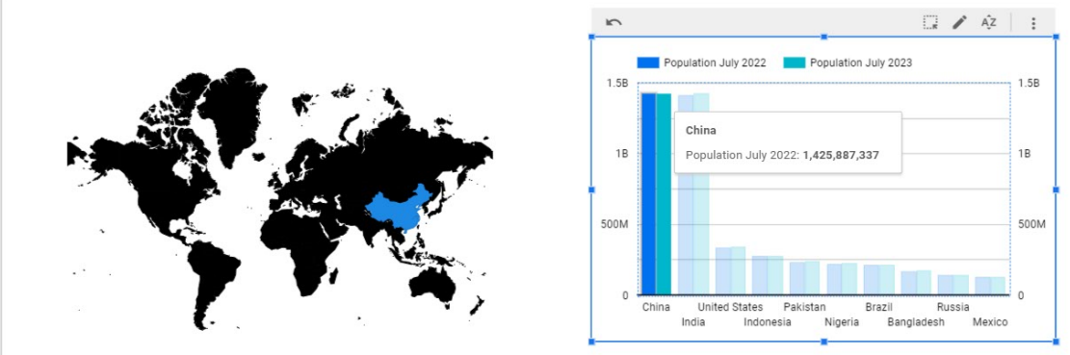
Data Visualization and Interpretation
Figures 24, 25: The above charts show the population in July 2022 and July 2023 where the first visualization shows that Dark blue is the most populated as the lighter one is less populated. The second image shows the most populated country in the bar graph, and the same is represented in the world map
Figure 26: This treemap shows the change in population in each country where it is easier to find which country has experienced the most significant change in the population.
World countries by population

Slide 15
References
https://en.wikipedia.org/wiki/List_of_countries_by_population_(United_Nations)
https://unt.instructure.com/courses/102238/modules
https://colab.research.google.com/drive/16AMlkHpbigef7dJf2yU3MNQg_gY2XSsZ
World countries by population

Slide 16
Thank You!

